Slide 1
WORKPLACE PROFESSIONAL COMMUNICATION SKILLS

Slide 2
WPCS Module Assessment
1) Assignment (50%) – In Group
2) Managing Meeting (30%) – In group
3) Letter Writing (20%) - Individual

Slide 3
COMMUNICATION AT WORKPLACE 1 - Elements of communication process - Academic models of communication process
WORKPLACE PROFESSIONAL COMMUNICATION SKILLS

Slide 4

COMMUNICATION

Slide 5
Elements of Communication Process
The Sender
The Receiver
The Message Interference
The Medium
Feedback

Slide 6
Elements of Communication Process
The Sender:
- The communication process begins with the sender, who is also called the communicator or source.
- The sender has some kind of information, a command, request, or idea that he or she wants to share with others.
- In order for that message to be received, the sender must first encode the message in a form that can be understood and then transmit it.

Slide 7
Elements of Communication Process
The Receiver
- The person to whom a message is directed is called the receiver or the interpreter.
- In order to comprehend the information from the sender, the receiver must first be able to receive the sender's information and then decode or interpret it.

Slide 8
Elements of Communication Process
The Message
- The message or content is the information that the sender wants to relay to the receiver.
- It is relayed between the parties. Put all three together and you have the communication process as its most basic.

Slide 9
Elements of Communication Process
The Medium
- Also called the channel, the medium is the means by which a message is transmitted.
- Text messages, for example, are transmitted through the medium of cell phones.

Slide 10
Elements of Communication Process
Feedback
- The communication process reaches its final point when the message has been successfully transmitted, received, and understood.
The receiver, in turn, responds to the sender, indicating comprehension.
Feedback may be direct, such as a written or verbal response, or it may take the form of an act or deed in response.

Slide 11
Elements of Communication Process
Interference
The communication process isn't always so simple or smooth, of course. These elements can affect how information is transmitted, received, and interpreted:
Noise: This can be any sort of interference that affects the message being sent, received, or understood. It can be as literal as static over a phone line or esoteric as misinterpreting a local custom.
Context: This is the setting and situation in which communication takes place. Like noise, context can have an impact on the successful exchange of information. It may have a physical, social, or cultural aspect to it.

Slide 12
Academic models of communication process

Slide 13
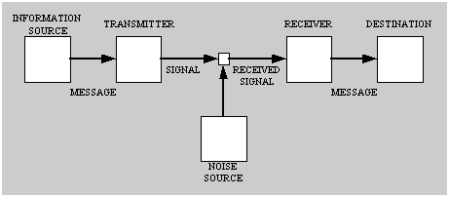
1) Shannon's (1948) Model of the communication process.

Slide 14
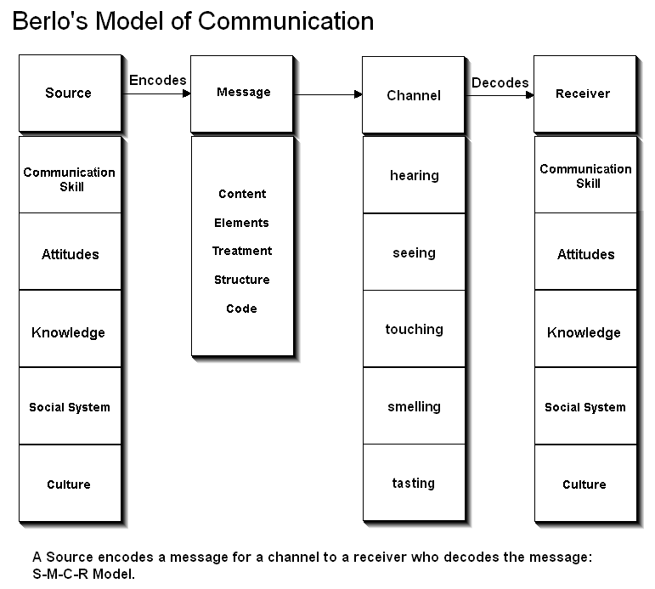
2) Berlo’s Model of Communication

Slide 15
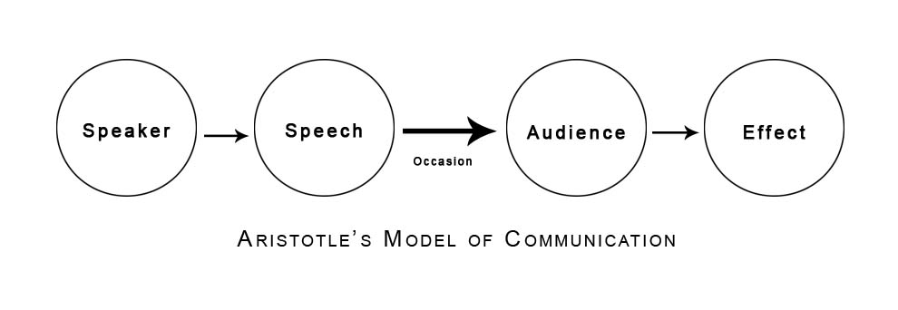
3) Aristotle's Model of Communication

